Slide 1
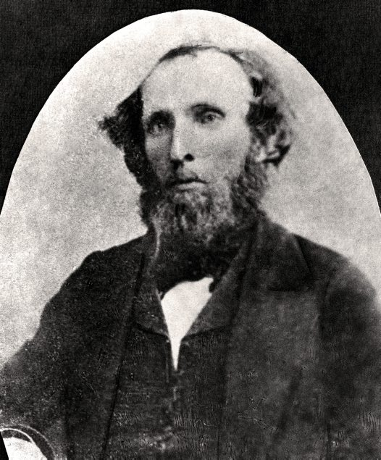
William Sheridan Wall

Slide 2
WHO IS HE?
William Sheridan Wall was born in Ireland on 22 October 1815, and studied anatomy at Trinity College, Dublin before moving to Sydney in 1840 with his brother Thomas. They both worked as naturalists at the Australian Museum.

Slide 3
When and where
.
In 1844, Wall and a bullock team made a collecting expedition along the Murrumbidgee River under the direction of George Macleay. Compared to other expeditions of the time, it wasn’t particularly troublesome or remote, basically following the weekly stage coach route that is now the Hume Highway

Slide 5
What the explorer did
Wall also managed to collect 138 birds and 16 Mammals and several other species at Gundagai where wall collected and classed his bird specimens.

Slide 6
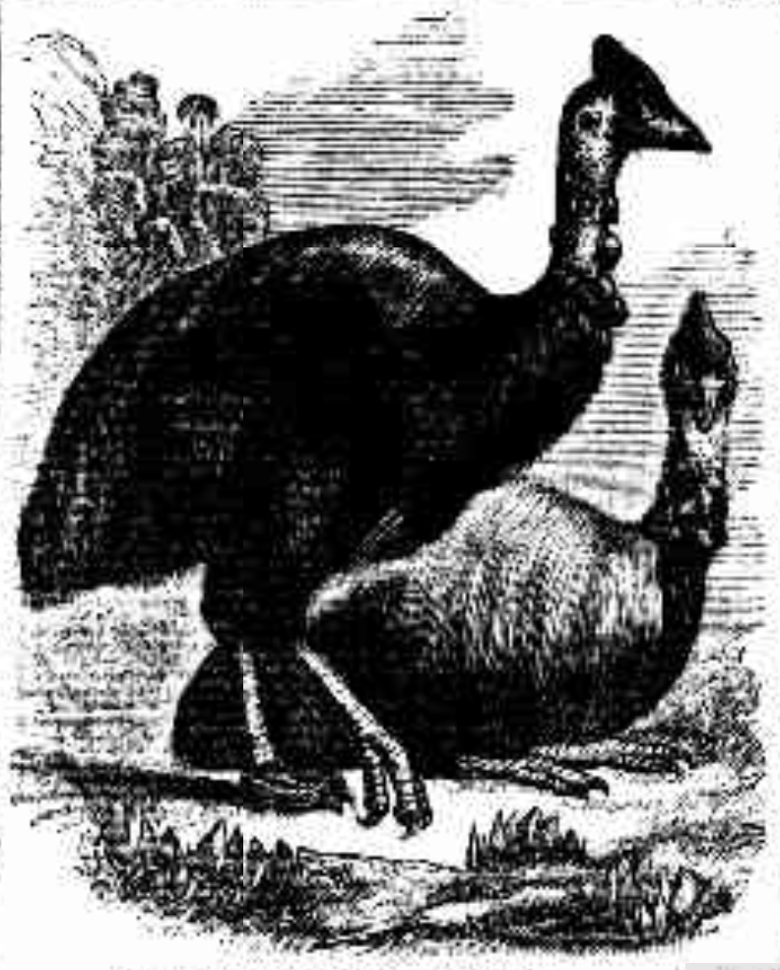
The importance of the exploration
At Gundagai Wall collected and classed his bird specimens.

Slide 7
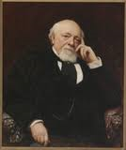
Who sent the explorer
George Macleay

Slide 8
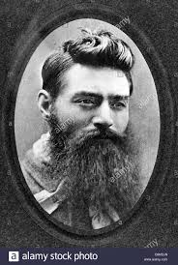
More on the trip
Miserable weather met with a mild encounter with a bushranger and lack of decent food. His stomach was very raw and sore.

Slide 9
The explorers life
Wall was born in Ireland on 22 October 1815 and studied anatomy at trinity collage Dublin before coming to Sydney in1840 with his brother Thomas . They both worked as naturalist at the Australian museum in 1847 William wall and explorer Ludwig Leichhardt reconstructed a diprotodont skeleton but his most popular move was preparing and mounting the skeleton of a sperm whale displaying it outside the museum in 1858 and died in 1876.

Slide 10
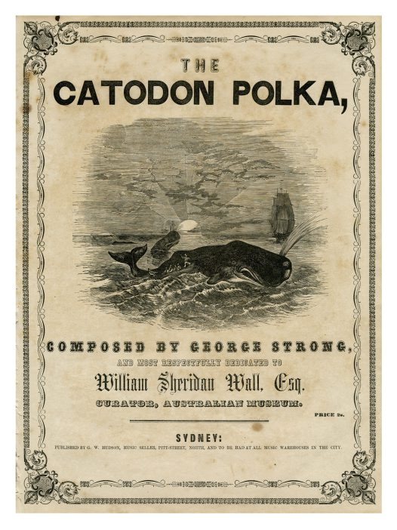
picture

Slide 11
BY CAELAN

