Slide 1
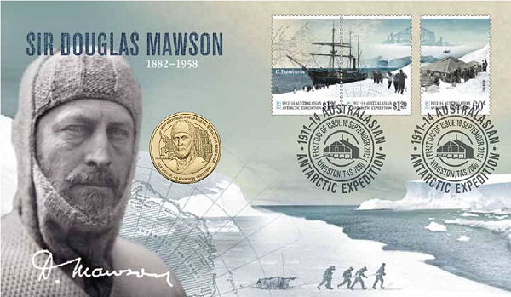
Sir Douglas Mawson

Slide 2
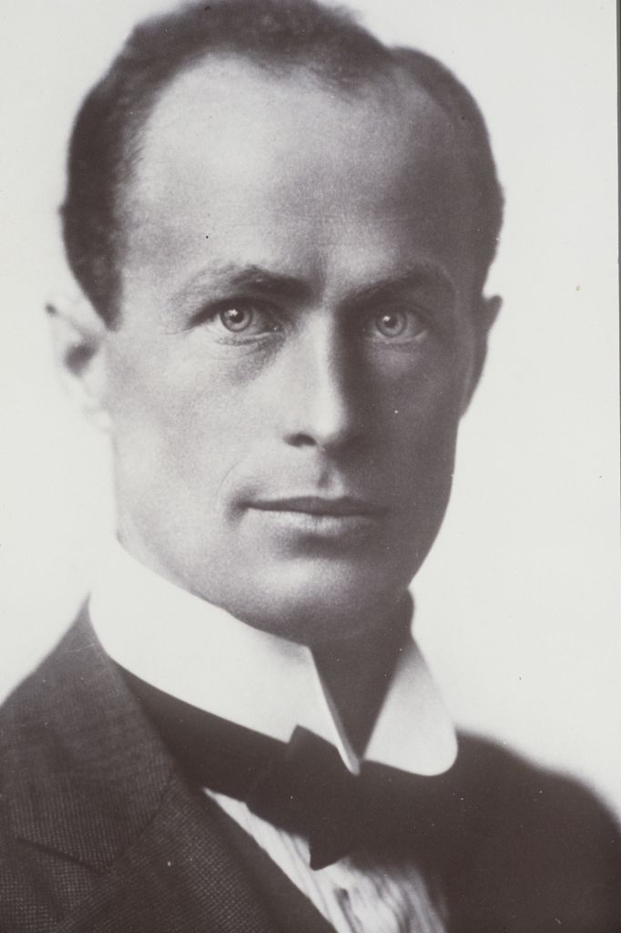
What the Explorer Did
Mawson completed the longest Antarctic man hurling sledge journey of 122 days
Coping with hunger, hidden crevasses, frostbite and exhaustion, they received a heroes welcome on their return.

Slide 3
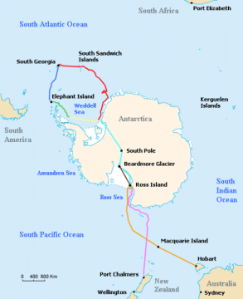
When and Where
In November 1912 departed the main base unaware of the tragedy about to unfold. The ship was lost with most of the supplies.
They struggled 30 days and missed the ship.

Slide 4
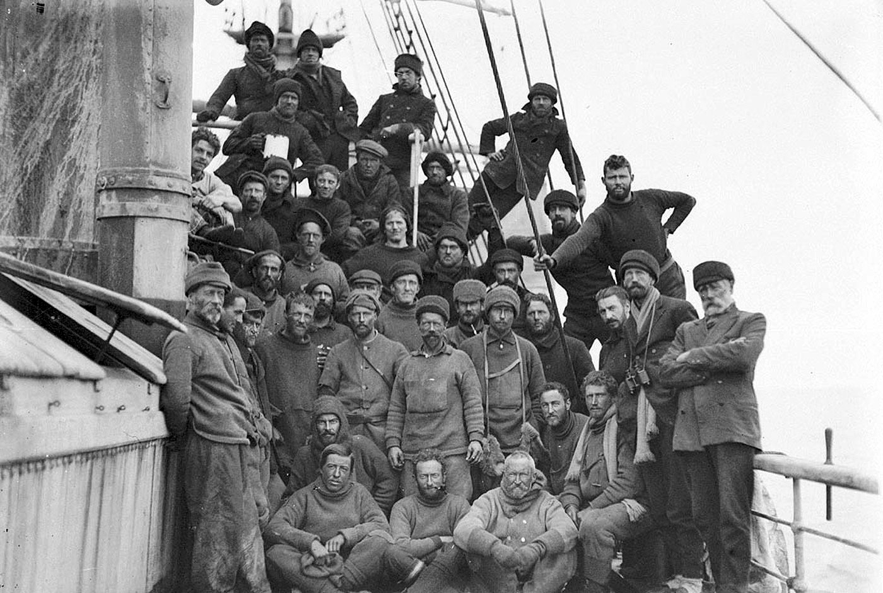
More on the Trip
Mawson went with David Edgeworth , Ernest Shackleton, and Kobert F, Scotts team. They explored in a ship called The Discovery, Once on foot 2 of his companions died and he explored on his own through blizzards and crevasses and the soles of his feet separated from his flesh.

Slide 5
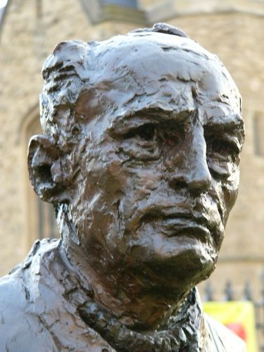
The Explorer’s Life
Douglas Mawson was born in Yorkshire on May 5, 1882. His parents took him to Sydney, New South Wales, when he was 4 years old.
He died in 1958

Slide 6
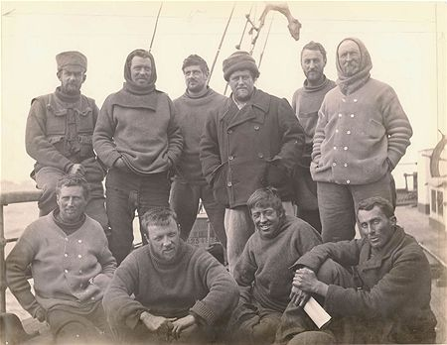
Fun facts
In 1907, Mawson joined an expedition to Antarctica led by Ernest Shackleton, as a scientific officer, and was one of the first to ascend Mount Erebus and get close to the South magnetic pole.
Having turned down an invitation to join Robert Falcon Scott's last fatal expedition, Mawson led his own party into King George V Land[?] and Adelie Land in 1911.
A disastrous turn of luck led to his enduring several weeks alone with minimal supplies, after the loss of his companions, and on his return he was too late to be picked up by ship and was forced to remain in Antarctica until early 1914.

Slide 7
BY RAYDEN BENN

