Slide 1
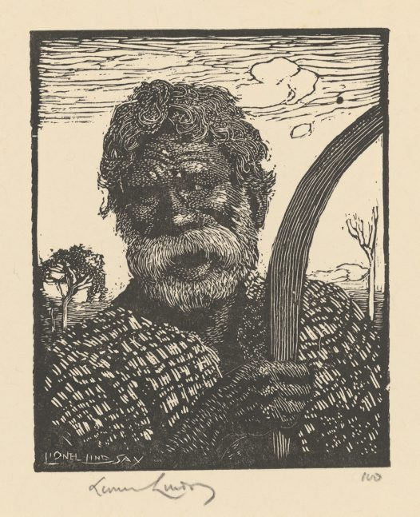
Jackey Jackey

Slide 2
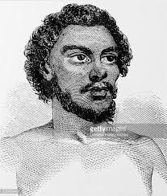
WHO WAS HE?
Jackey Jackey (d.1854), Aboriginal guide, was a member of a tribe of the Merton district near Muswellbrook.
His real name was
Galmahra

Slide 3
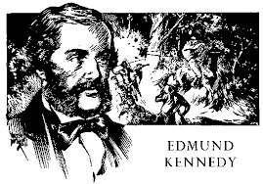
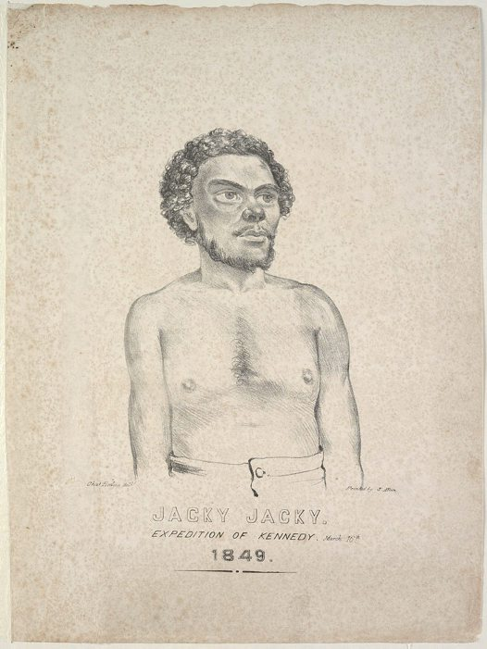
What the explorer did
Jackey Jackey
In 1848 he was selected to accompany the
explorer Edmund Kennedy on his expedition in
Cape York Peninsula.

Slide 4
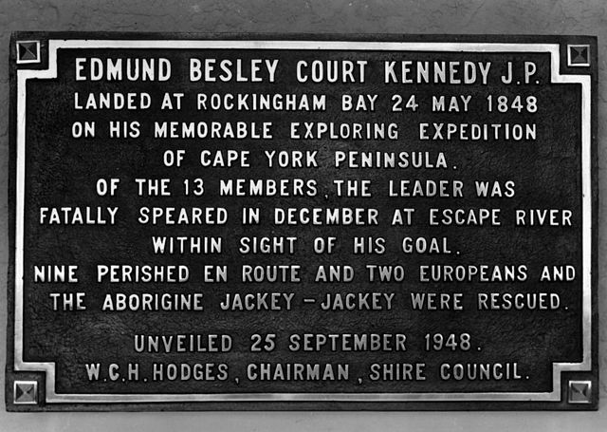
More on the trip:
Jackey Jackey went with Edmund Kennedy and 12 other men in 1848 to find a Northern point to make a port in. As the explorers got weak they got left behind. Kennedy was speared by Aboriginals , Jackey Jackey made it all the way.

Slide 5
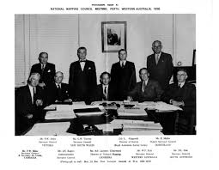
Who sent the explorer
The Surveyor Generals Department.

Slide 6
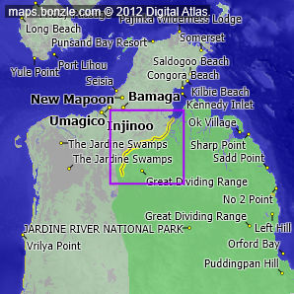
The importance of the Exploration
They wanted to map the East Coast of Queensland to find a site for a port.

Slide 7
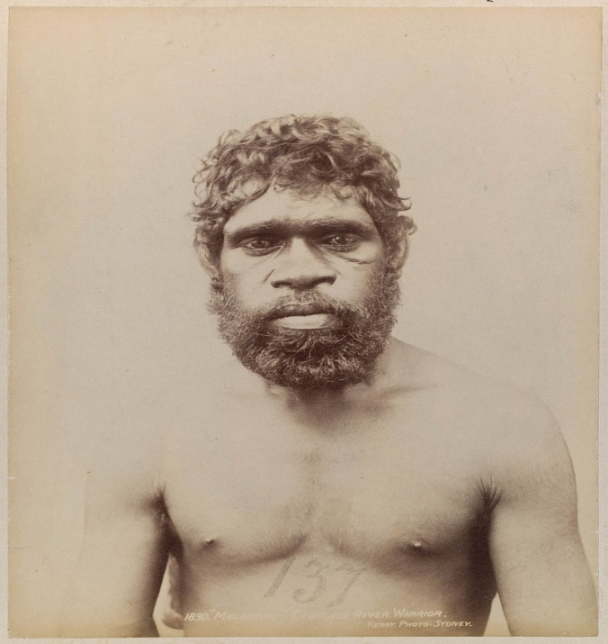
The Explorer life:
Born: UNKNOWN
Dies: 1854
An aboriginal guide was a member of the Meron district near Musswelbrooke. He was probably little more than a boy when at short notice in April 1848 was selected to accompany the explorer Edmund Kennedy on his expedition in Cape York Peninsula

Slide 8
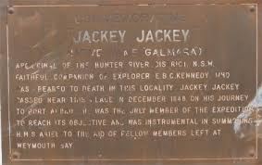
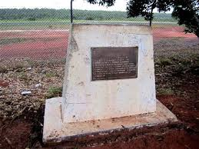
HOW HE DIED
He died in 1854 when he was drunk and collapsed into a campfire.
He was burned to death.

Slide 9
BY JOSHUA SCHROEDER

